Slide 1
If I were a dog for a day...

Slide 2
If I were a dog for a day...
Pull out a notebook or piece of paper and something to write with.
Answer the following questions by doing one of the following:
drawing a picture
drawing a comic strip
writing a story
writing a poem
writing a song

Slide 3
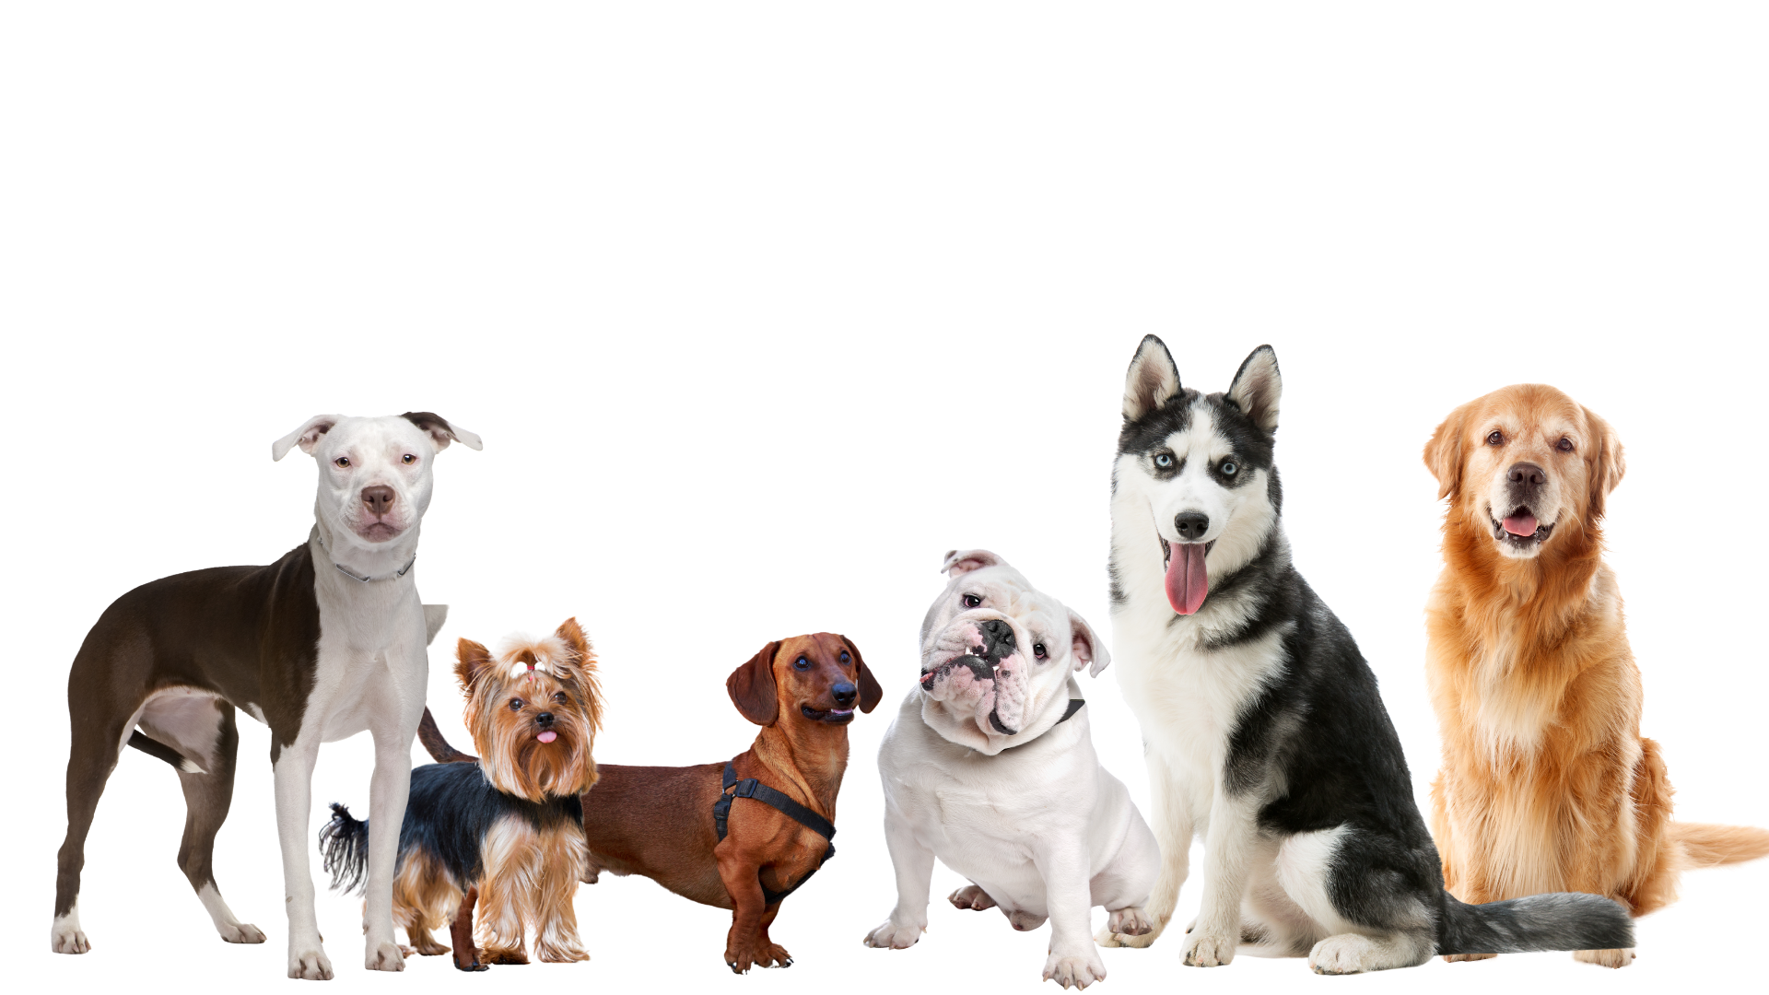
If I were a dog for a day...
What kind of dog would I be?

Slide 4
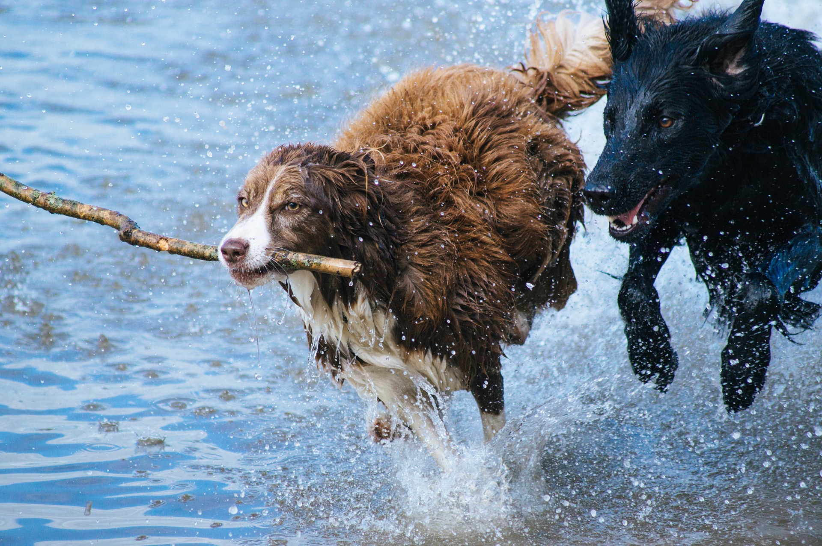
If I were a dog for a day...
What would I do?

Slide 5
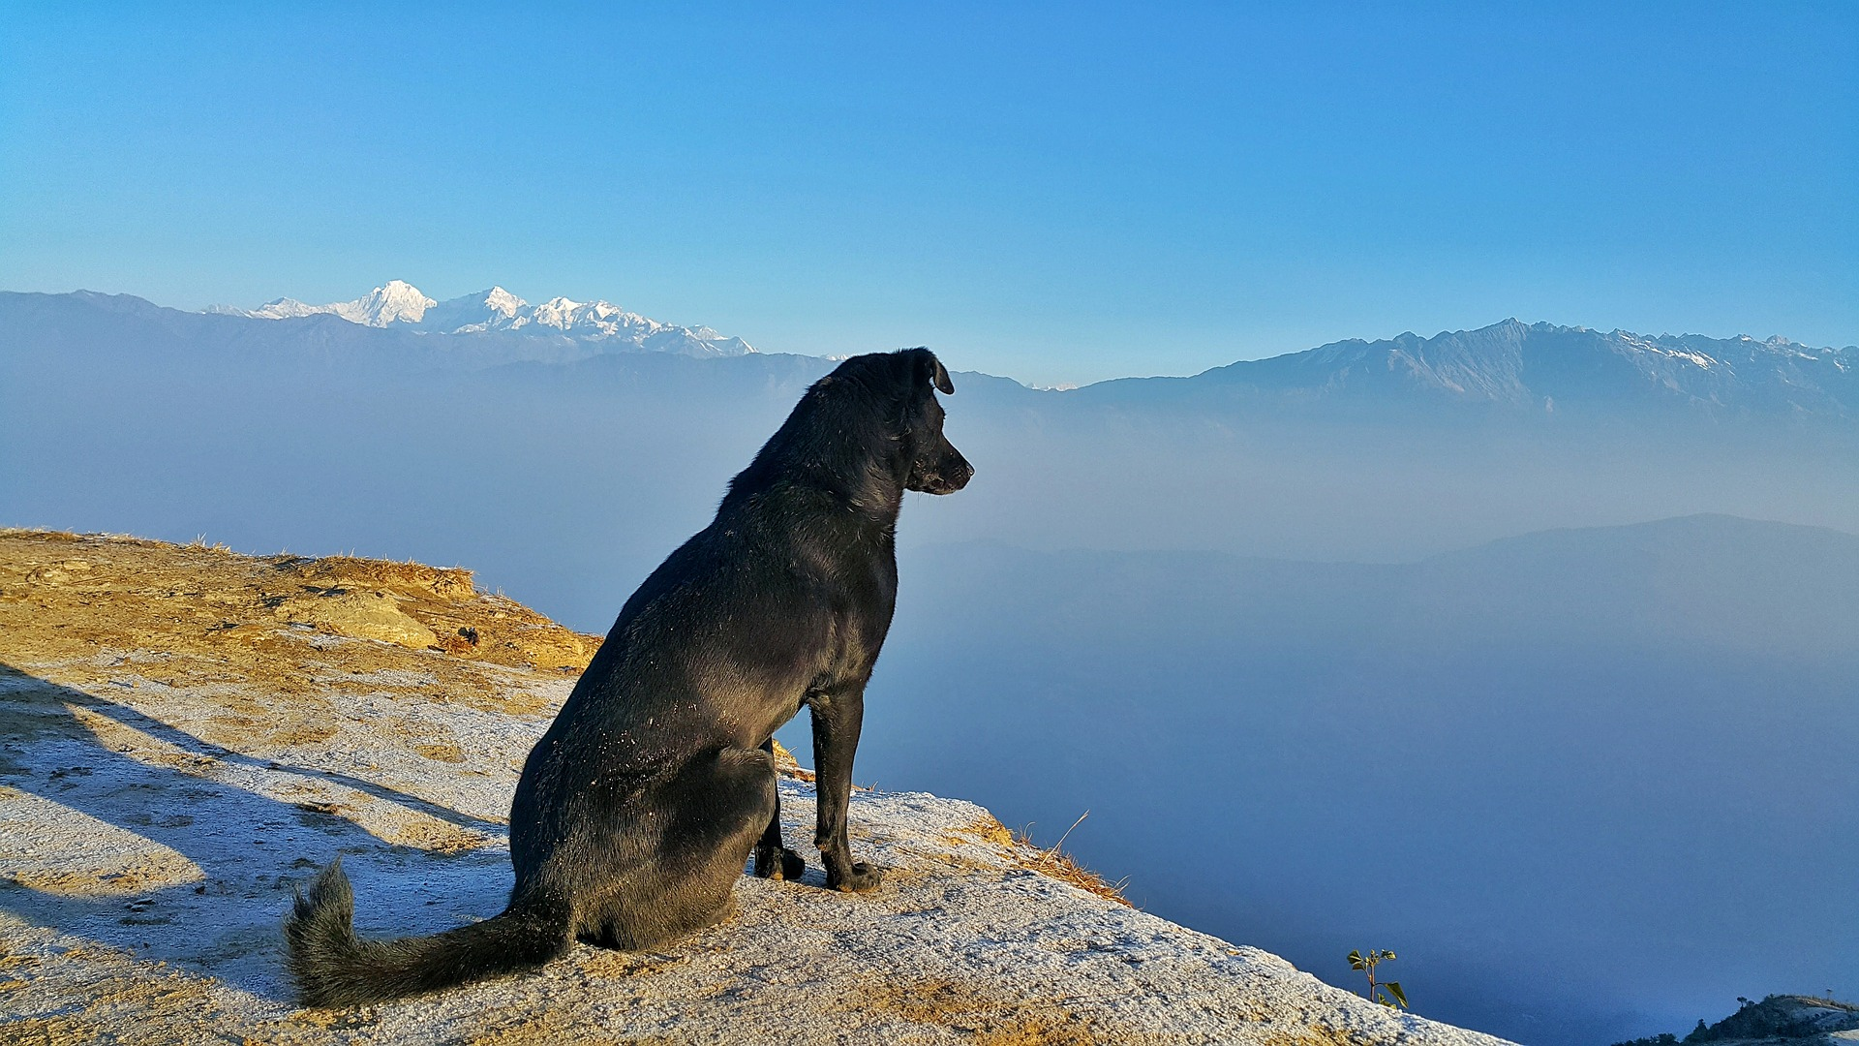
If I were a dog for a day...
Where would I go?

Slide 6
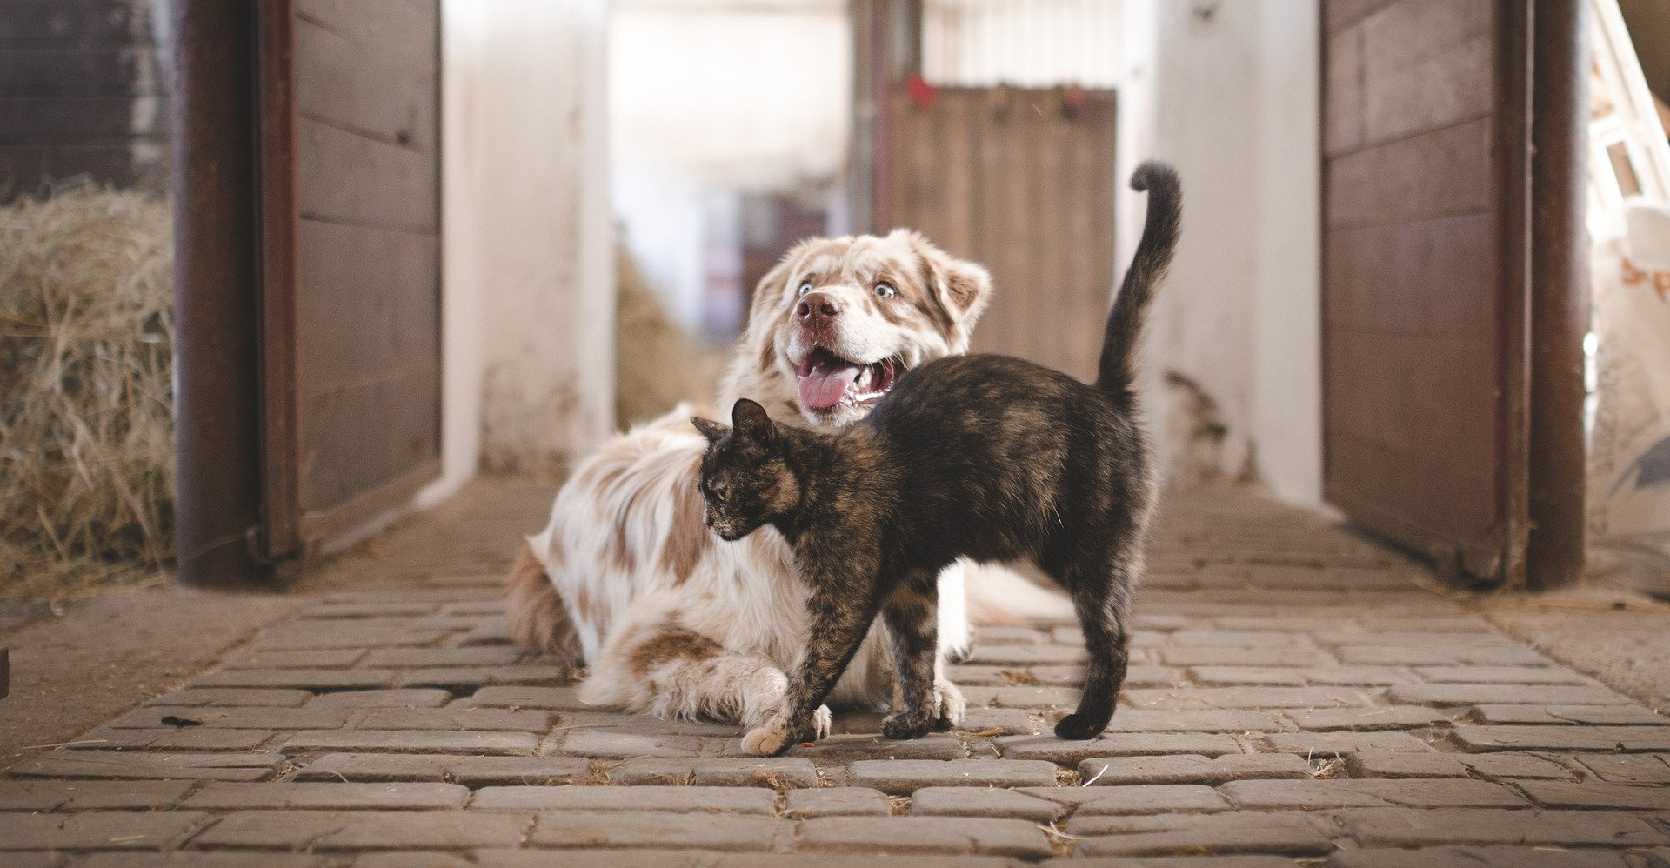
If I were a dog for a day...
Who would I meet?

Slide 7
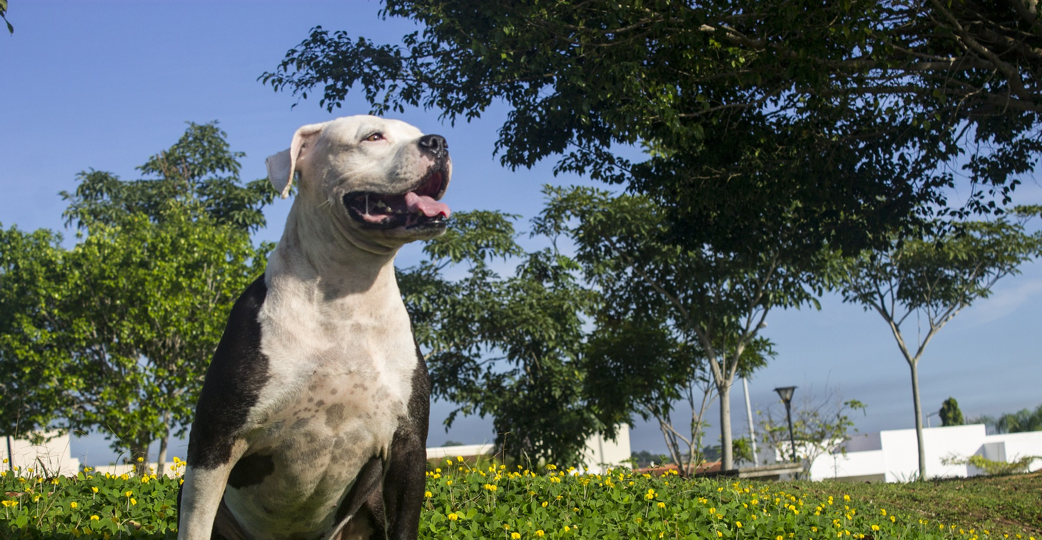
If I were a dog for a day...
How would I feel?

Slide 8
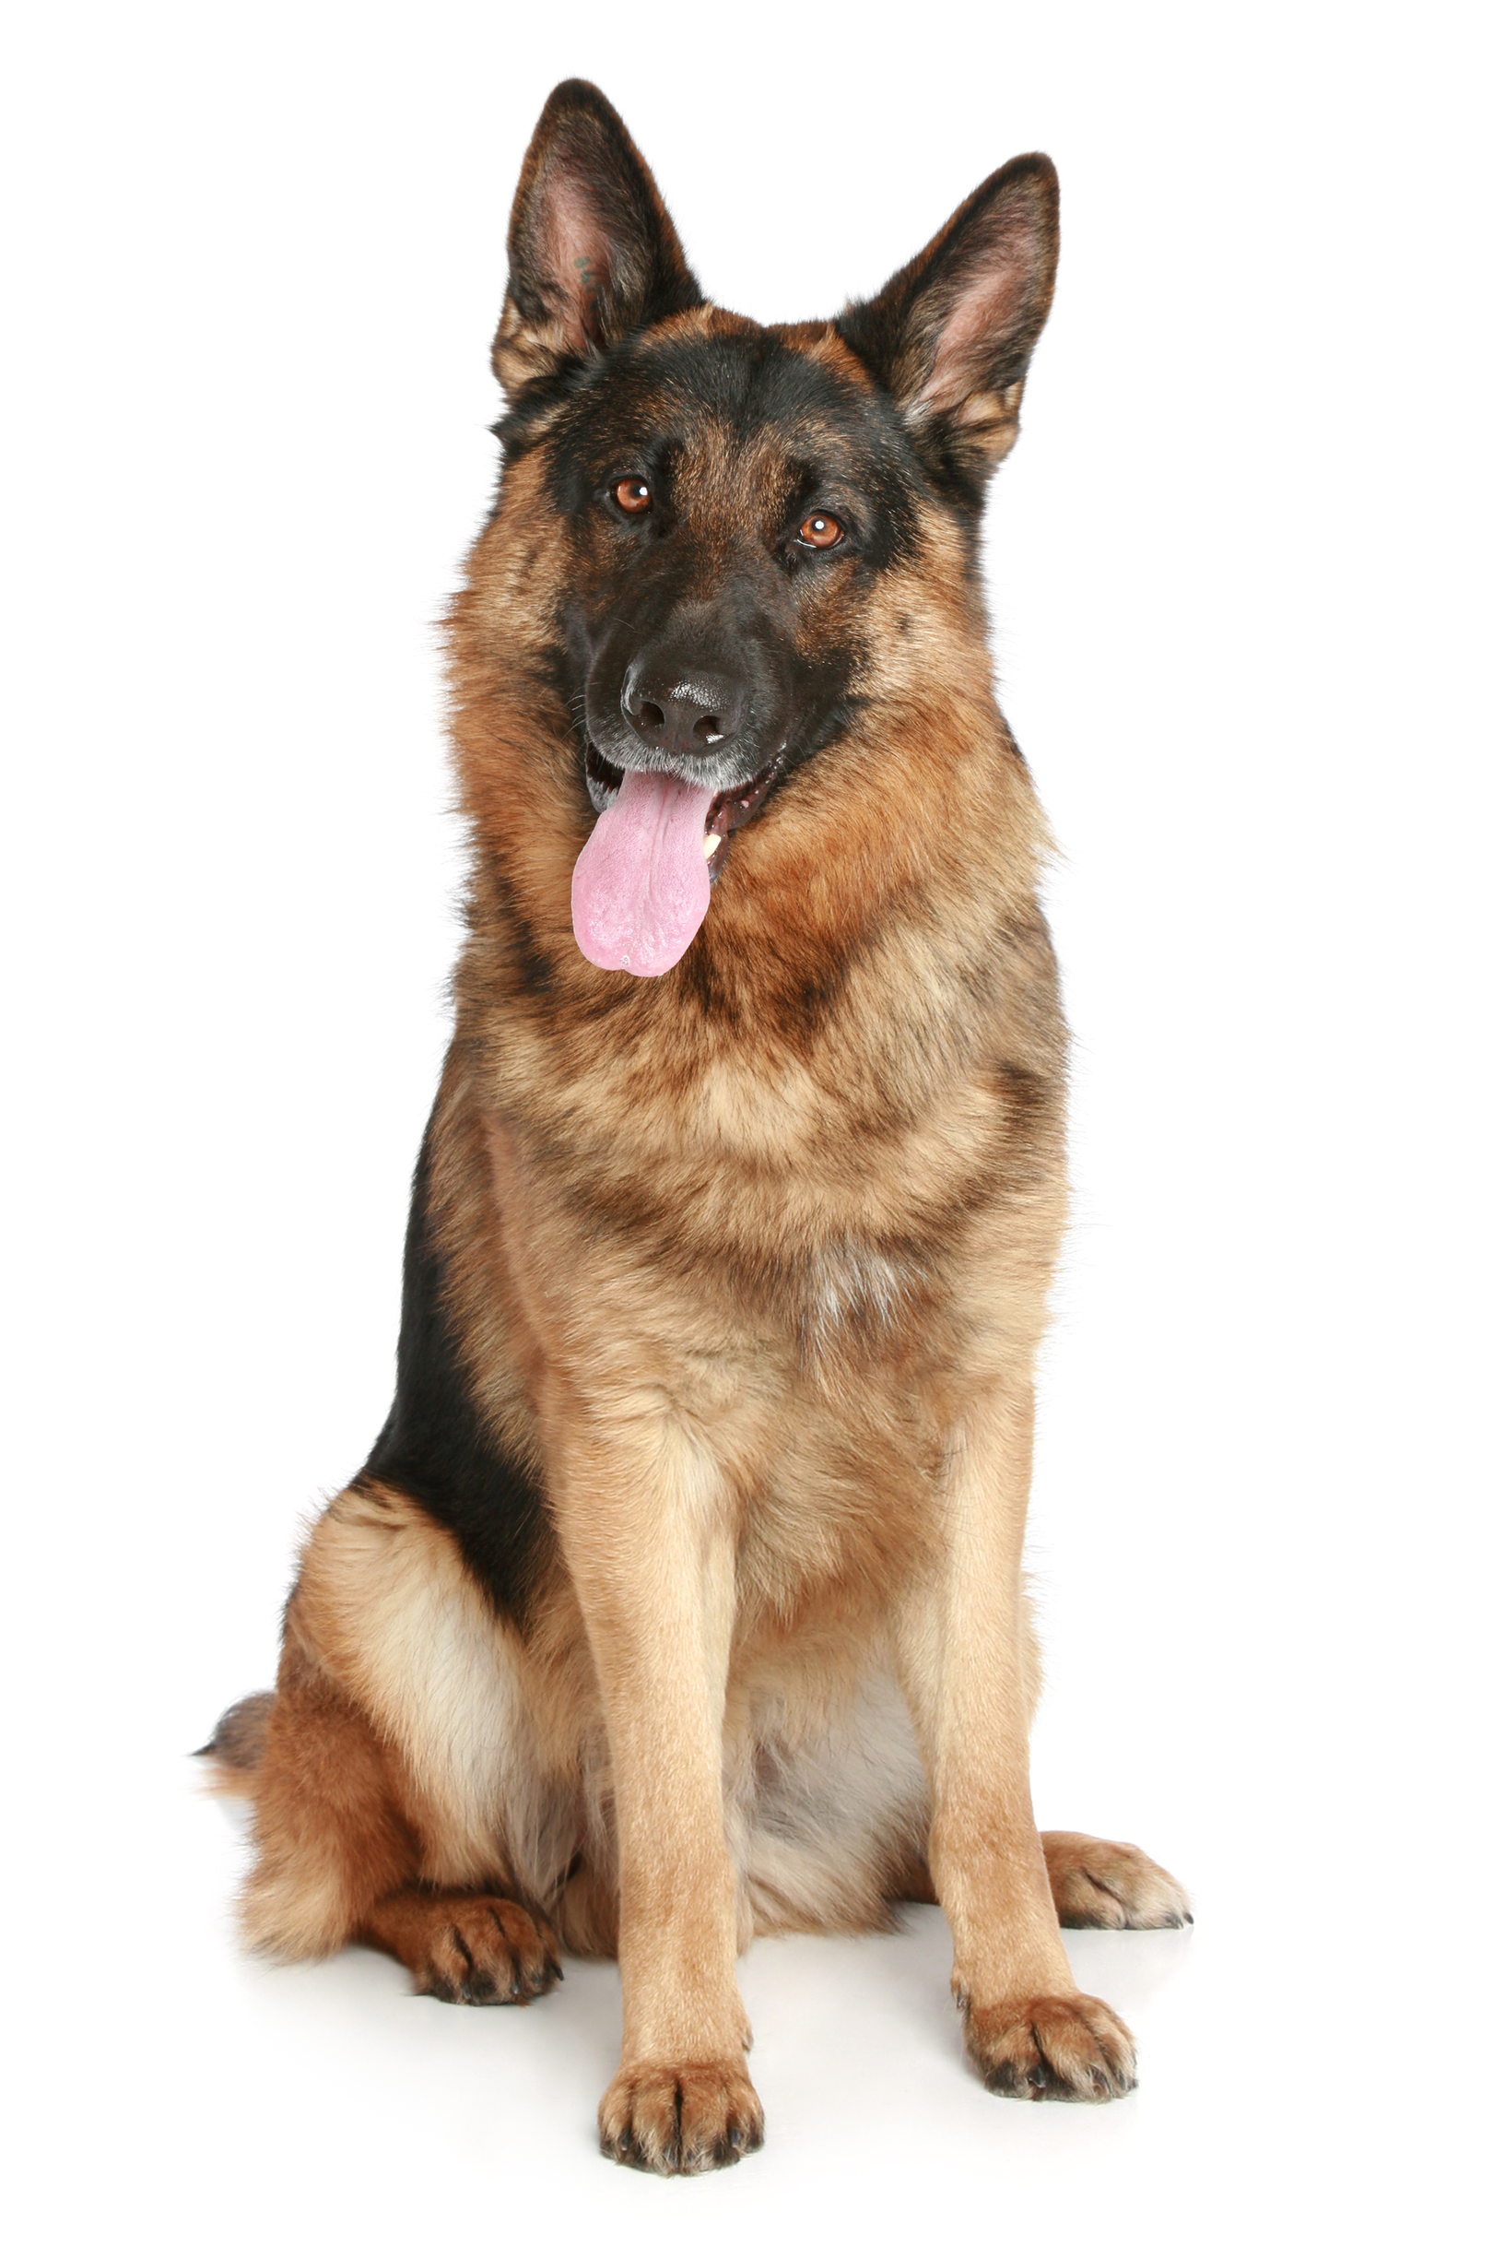
If I were a dog for a day...
How did you feel about today’s book and discussion?
Did today’s book and discussion change how you think about anything in your life?
What did you learn from today’s book and discussion that you didn't know before?

