Slide 1
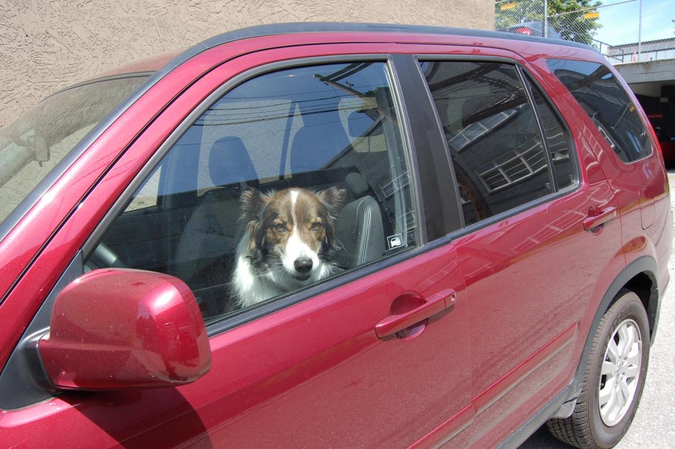
The Dangers of Dogs in Hot Cars:
Teaching Guide
Notes:
This PowerPoint is intended to be used in conjunction with RedRover’s complete “The Dangers of Dogs in Hot Cars” teaching guide, available at www.RedRover.org/MDIClesson.
Copyright 2018

Slide 2
Part 1: Introduction to topic and data collection
Have you ever left anything in a hot car that melted or was ruined because of heat, such as a chocolate candy bar? What was it?
YouTube video link: https://www.youtube.com/watch?v=lu9Og8y4-fI
Explain what you saw in the video.
Why do you think this is important?

Slide 3
Experiment: How hot do cars get?
Create a table to take notes: time, outside temperature, inside temperature
Note conditions of car/model
We will note the temperatures every _____ minutes for a total of ______ minutes.
Notes:
See sample data and examples on following slides.

Slide 4
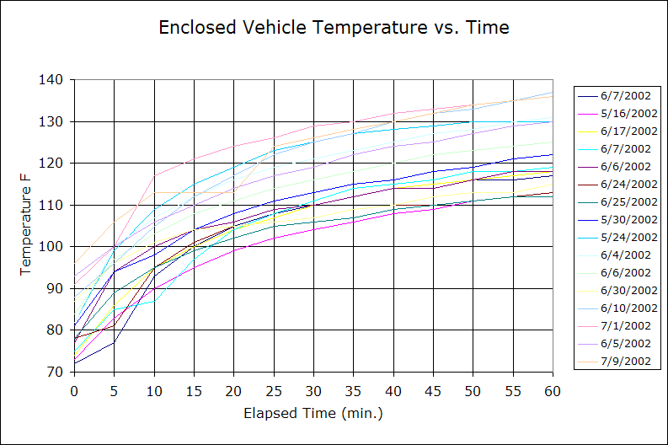
Notes:
This is real data from a study posted on Golden Gate Weather Services. Source: http://ggweather.com/heat/

Slide 5
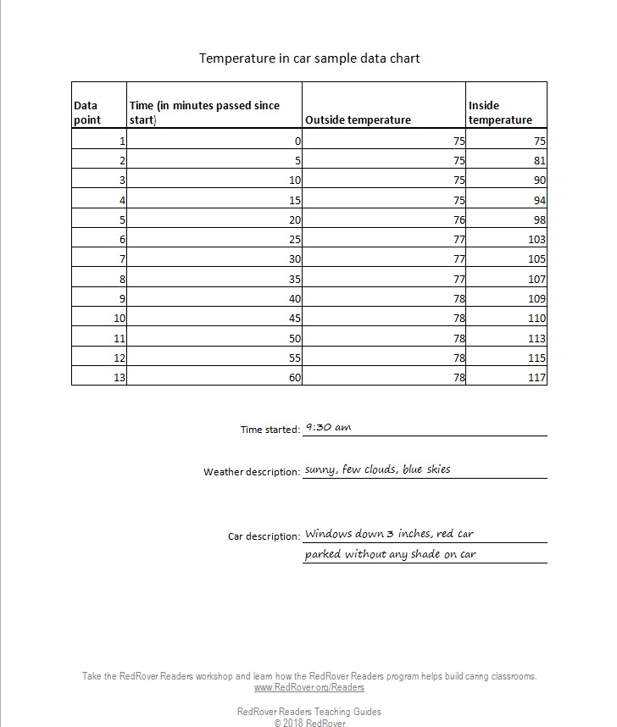
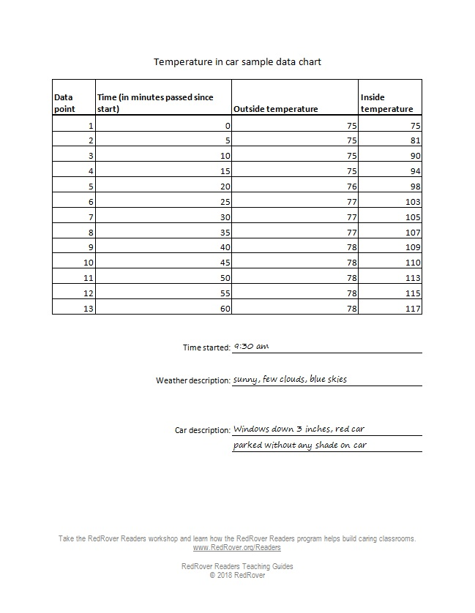
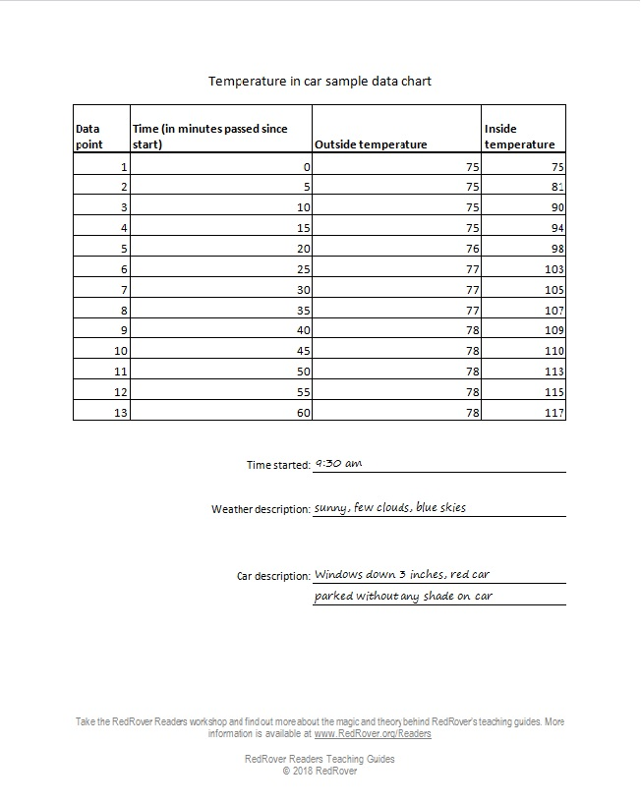
Notes:
Sample data collection table
Printable handouts available at www.RedRover.org/MDIClesson

Slide 6
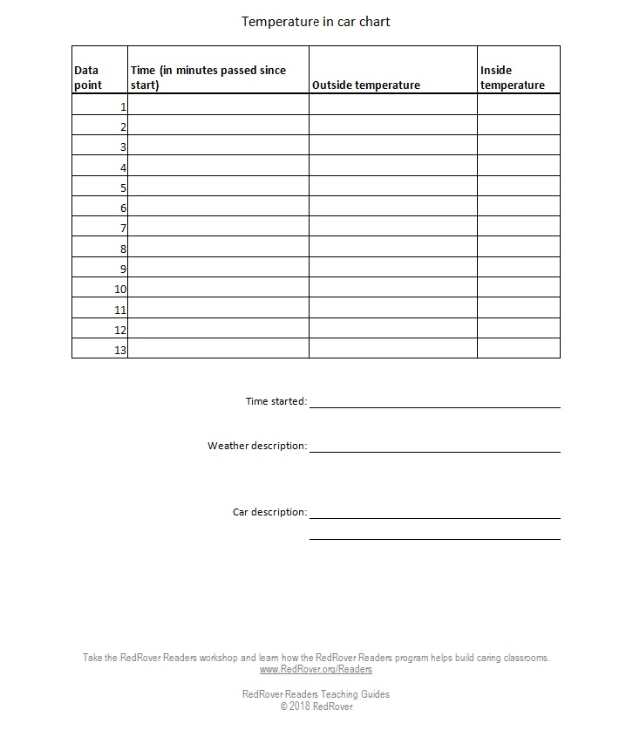
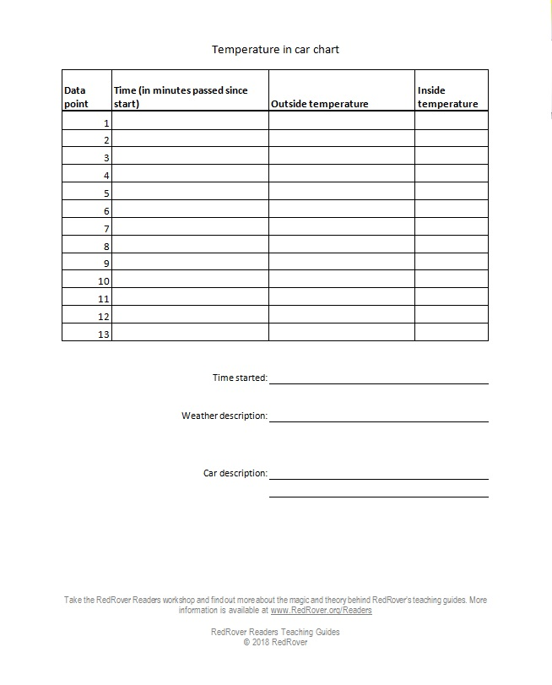
Notes:
Blank data collection table
Printable handouts available at www.RedRover.org/MDIClesson

Slide 7
Experiment: How hot do cars get?
Create a graph using the data you collected.
X axis: time since start (e.g. 5, 10, 15, 20…)
Y axis: temperature (e.g. 60, 70, 80, 90…)

Slide 8
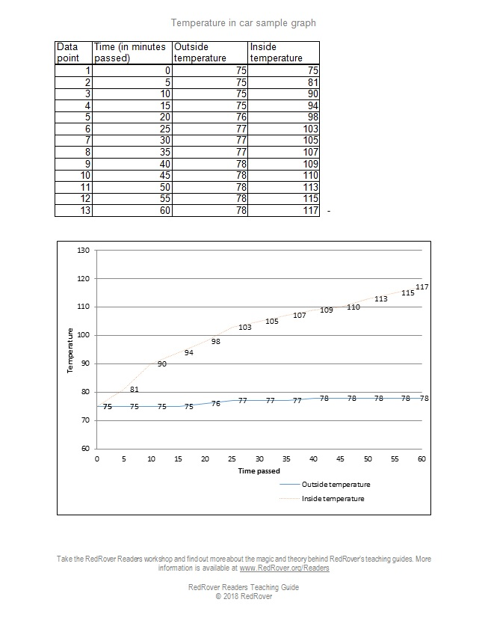
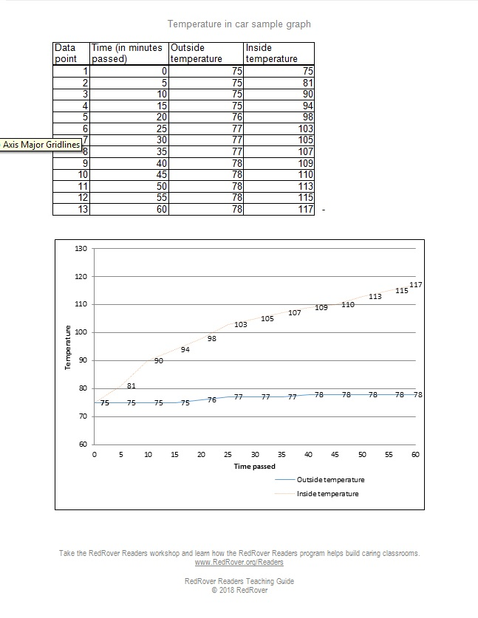
Notes:
Sample graph
Printable handouts available at www.RedRover.org/MDIClesson

Slide 9
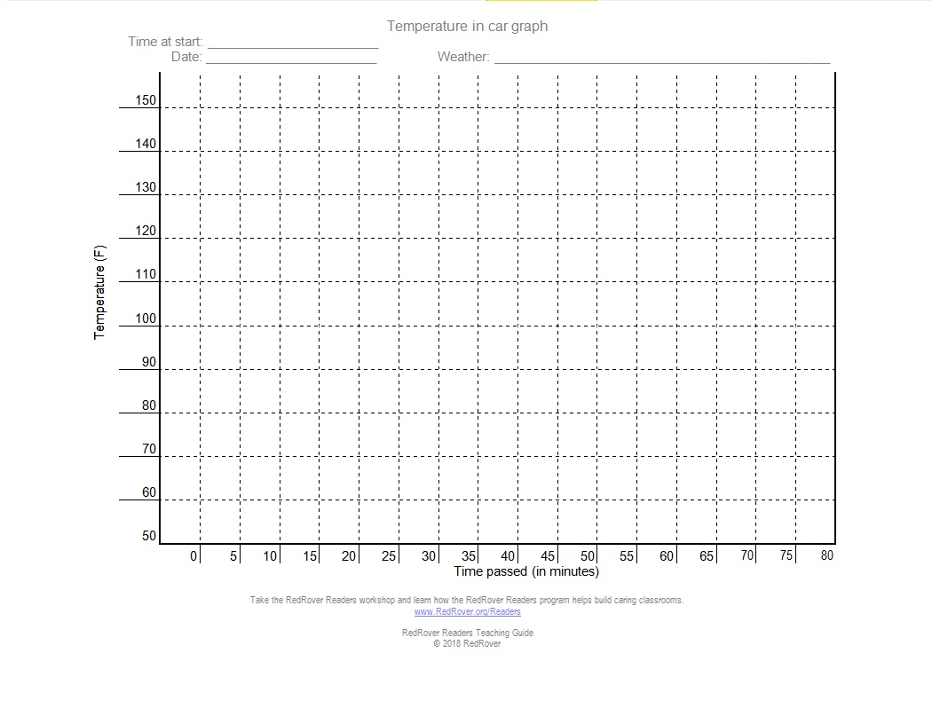
Notes:
Blank graph
Printable handouts available at www.RedRover.org/MDIClesson

Slide 10
Part 2: Applying knowledge to real-life situations
What we will do:
Learn about real-life cases of dogs left in hot cars
Physics: why cars heat up
Biology: dog and human cooling systems
Application: spreading the word

Slide 11
Case study 1
In April, 2013, two cases of dogs left in cars made headlines. In Virginia, a woman parked her car in a shaded area and cracked the windows, and left her 7-year-old cocker spaniel and 5-year-old cocker spaniel-poodle mix in the car while she shopped. The outside high temperature that day was 91 degrees, sunny with some clouds. She came back an hour later and saw police officers standing near her car. Unfortunately, both her dogs had died. She was arrested and charged with two counts of animal cruelty.
Notes:
Recommendation: Add your own recent case studies from your own area. Visit www.MyDogIsCool.com/reports to find recent cases, or do an Internet news search.

Slide 12
Case study 2
In Massachusetts, a student at Cape Cod Community College left his golden retriever in the car while he went to class. The police were called to rescue the dog because the dog was heavily panting. Even though it was only around 70 degrees that day and overcast, the temperature inside the car was 106 degrees. The dog was rescued and will be OK. The student was arrested on animal cruelty charges.
Notes:
Recommendation: Do an Internet news search to add your own recent case studies from your own area.

Slide 13
Discussion
What is your reaction to these stories? Did anything surprise you?
What do you know so far about why it’s dangerous for dogs to be left in a hot car?

Slide 14
Physics: Observation
What do you notice happens when you leave a car in the sun and come back to it?
What are some variables that could change what happens to the temperature inside a car?
Outside temperature: e.g. 95 degrees vs. 75 degrees vs. 30 degrees
Shade
Windows
What else? e.g. color of car

Slide 15
Notes:
The sun’s energy passes through the windshield and is absorbed by the interior of the car, such as the seats and dashboard.
Light energy turns into heat energy.
The heat energy is re-radiated from the car’s interior, but it cannot pass back through the glass and the car warms up!

Slide 16
Physics: Discussion
Can you think of anything that uses this physics concept in order to work?
Thinking about a car heating up, what are some reasons to explain why cracking the windows does not cool the car very much?
Notes:
(Possible answers: greenhouse, solar oven, camping water heater, solar panel)

Slide 17
Physics: Data
Let’s revisit the graph we created.
What do you notice about the data?
Does it match the hypothesis we created? Why or why not?
Notes:
(Possible answers: greenhouse, solar oven, camping water heater, solar panel)

Slide 18
Physics: Data
How is the data that we collected similar/different from the data collected in the sample study?
Notes:
(Possible answers: greenhouse, solar oven, camping water heater, solar panel)

Slide 19
Biology: Discussion
Imagine it’s hot outside. What happens to your body when it is hot?
What can you do to help your body cool itself when you’re too hot?
How do these things work to cool a person’s body?
Notes:
Possible answers:
Sweating
drink water, mist water onto body, etc
Evaporative cooling

Slide 20
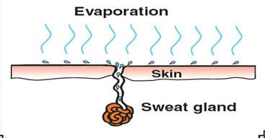
Biology: Vocabulary
Evaporative cooling is…when water heats up and evaporates into the surrounding air. When water molecules leave a person’s skin, they take heat with them.
Notes:
Source: http://www.fs.fed.us/t-d/pubs/htmlpubs/htm10512316/

Slide 21
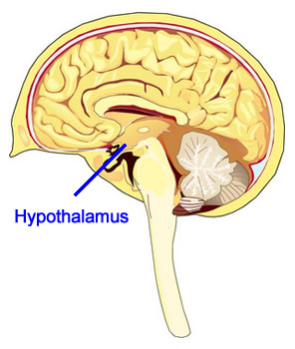
Biology: Vocabulary
Thermoregulation is…the physiological process controlling the balance between heat production and heat loss in the body so as to maintain body temperature. This is controlled by part of the brain called the hypothalamus.
Notes:
Source: http://www.kidport.com/RefLib/Science/HumanBody/NervousSystem/Hypothalamus.htm

Slide 22
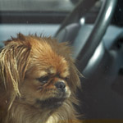
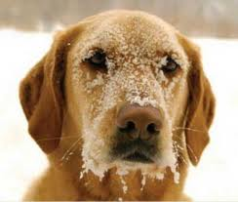
Biology: Vocabulary
Hyperthermia and hypothermia are…Hyperthermia is getting too hot; hypothermia is getting too cold. Both conditions can cause the body to shut down and can even cause death.

Slide 23
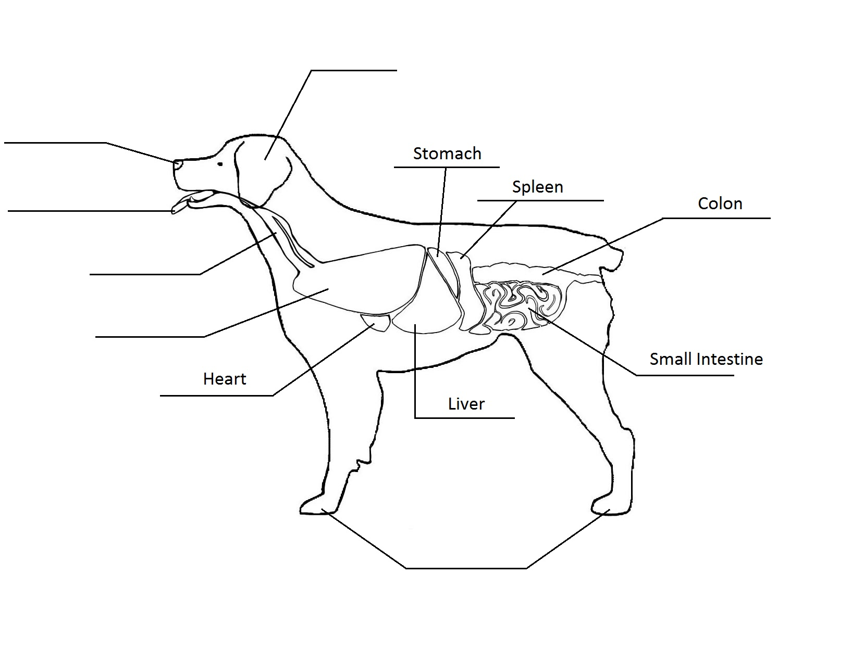

Slide 24
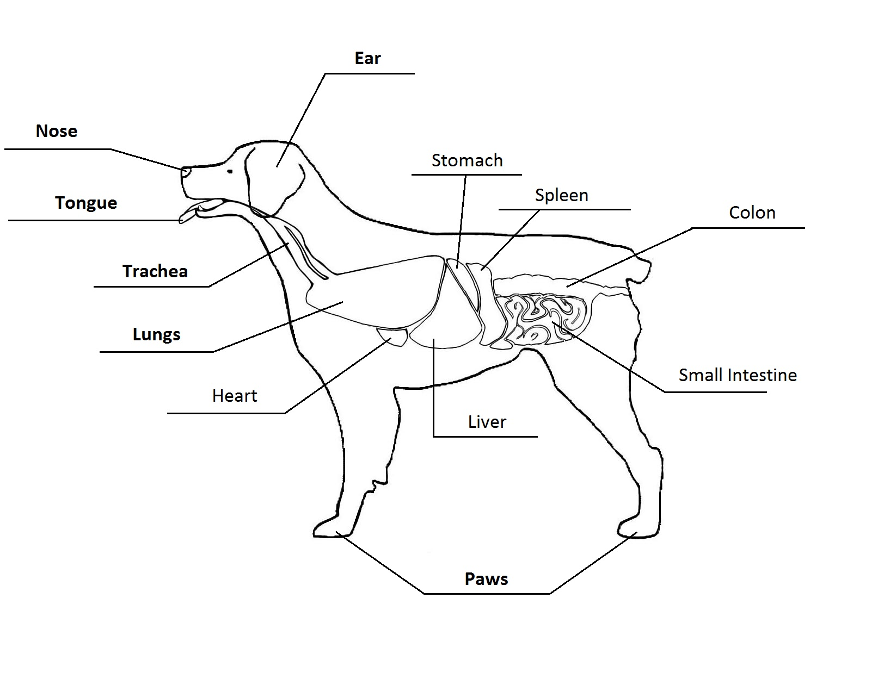
Notes:
Answer key

Slide 25
Biology: Dogs
_____________________ is a term that refers to the body’s temperature control system. Dogs have sweat glands located in their _____________________, but these do not help cool the dog very much in very hot temperatures, since these body parts are small compared to the rest of the dog. The main way that dogs cool themselves off is through _____________________. A dog’s _____________________ is moist and wide, making it possible for water to _____________________ from its surface, and take heat away with it. When a dog pants, it switches from normal breathing to fast, shallow breathing. This shallow breathing means that the dog is using its muscles to work its _____________________ harder. This increase in muscle use causes the dog’s _____________________ to work harder to pump blood to his muscles. Panting, like _____________________ in humans, is a form of _____________________.
Notes:
Answer key: (Thermoregulation) is a term that refers to the body’s temperature control system. Dogs have sweat glands located in their (paws and ear canals), but these do not help cool the dog very much in very hot temperatures, since these body parts are small compared to the rest of the dog. The main way that dogs cool themselves off is through (panting). A dog’s (tongue) is moist and wide, making it possible for water to (evaporate) from its surface, , and take heat away with it. When a dog pants, it switches from normal breathing to fast, shallow breathing. This shallow breathing means that the dog is using its muscles to work its (lungs) harder. This increase in muscle use causes the dog’s (heart) to work harder to pump blood to his muscles. Panting, like (sweating) in humans, is a form of (evaporative cooling).

Slide 26
Biology: Dogs
How does a hot car feel to a dog?
How might you know by observing the dog that he is too hot? List of symptoms: www.MyDogIsCool.com
A dog’s normal body temperature is about 100.5 degrees. Thinking about the graph that was made and the sample data, how do you know when it is too warm for a dog to be left in a car?

Slide 27
Application: Discuss
Based on what we learned today, why is leaving dogs in cars dangerous for the dog?
With this in mind and thinking about the real-life cases we discussed earlier, why do people still leave their dogs in the car?
Before this class, did you know how dangerous it is to leave dogs in a car?
What can people do when they see a dog suffering in a hot car?
What would you say to someone who is about to leave a dog in a car on a hot day?
What can this class do to spread the word about this issue?

Slide 28
Application: Skit
Create a short (2 minute) skit illustrating a situation that applies the concept of why it is dangerous to leave a dog in a hot car.
Idea starters:
A friend is about to leave their dog in the car and you encounter them. What do you say?
A dog owner leaves the dog in a car, thinking that going into the store will only take 5 minutes. But first they run into an old friend, then the item they came for is out of stock, then the line to purchase the item takes too long…
Be sure to portray the dog’s perspective!

Slide 29
Application: Poster
Create a poster advising people not to leave dogs in cars, including why it’s important as well as information learned in class to support your point.
If you were looking at posters, what would get your attention?
If you were going to create a poster to put on a store and tell customers not to leave their dogs, what would it say?

Slide 30
Conclusions / reflection
What did you learn about dogs in hot cars?
Who can you share this with? And why is it important to share?

Slide 31
Teachers: Report about your class experience!
Send in a quick report about your class doing this lesson plan!
Photos are welcome too!
Visit www.RedRover.org/MDIClesson to send in your report.

